Slide 1
Order history app on mobile app
Background
Assuming you are working for a huge e-commerce company called cadabra.com
Objectives
Have a client mobile app user been able to access their order history on an app via DynamoDB

Slide 2
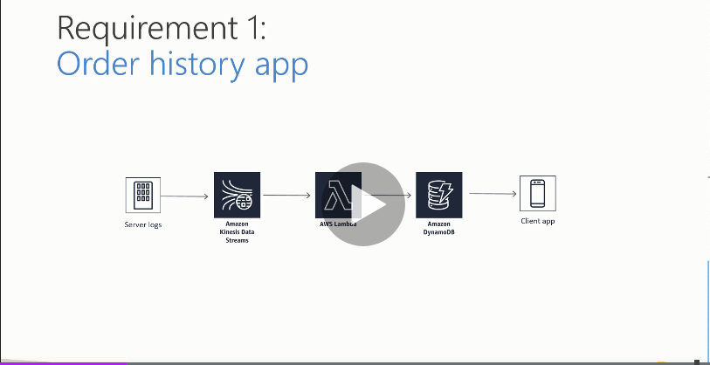
Design Solution Blueprint

Slide 3
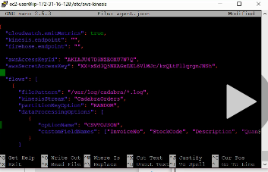
Agent file
Build the flows and direct the logs to be published into CadabraOrders, partitioned randomly and be converted from CSV to JSON in the agent.nano text file, invoices and some descriptions. To initiate the logs, type sudo service aws-kinesis-agent restart; then restart the logs by going to home directory and typing sudo ./LogGenerator.py

Slide 4
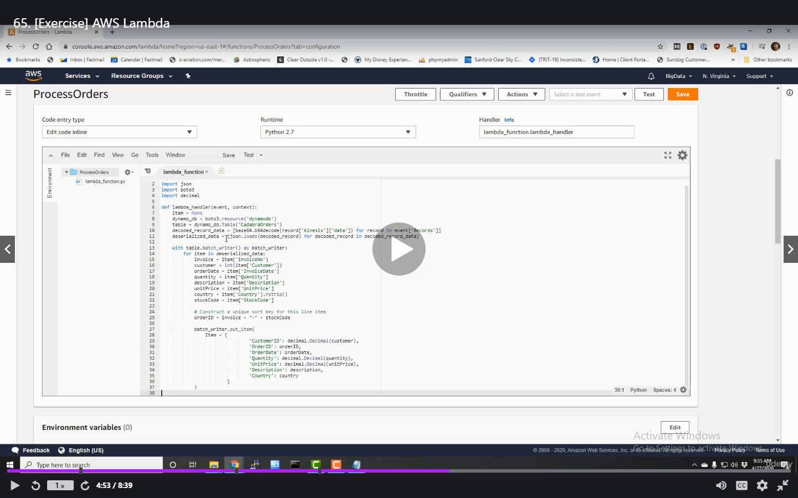
Lambda Function – Runtime Python3
Python code (Boto 3) run time in Lambda function. Parse out the data from Lambda and store in DynamoDB

Slide 5
Process
Mechanics
Simulate order data from an EC2 instance (Use CLI and configure our logs to write into the Kinesis data stream that was created)Kinesis agent in the EC2 instance pumping the data into Kinesis. Also edit the Kinesis agent file to convert the csv file to JSON file so that AWS Lambda can use it more easily
Publish that data using Kinesis data streams into and AWS Lambda function (For this project, we only need 1 shard (1 shard = 1MB/S of WCU, 2MB/S = RCU and 1000 records per sec)- Use Cloudwatch to view and monitor the data streaming into Kinesis
AWS Lambda will in turn populate a DynamoDB database (AWS Lambda is a serverless function and scale itself endlessly on as needed basis)- Lambda function needs to consume data from the Kinesis stream and write data into DynamoDB. The Lambda function will need a Kinesis trigger to activate the Kinesis stream into the Lambda function and then put the Lambda python3 code
Mobile app will read the order data history from Dynamo DB – DynamoDB is partitioned using Customerid (Number) which is most distributed key (UNIQUE) that will make it faster for our customers to quickly retrieve their order history. Also add a sort key (Orderid -string) to help facilitate the search.

Slide 6
Security
AWS Lambda will need IAM roles that will enable it to consume data from Kinesis data streams (AmazonKinesisReadOnly role) and another IAM role (AmazonDynamoDBFullAccess) to be able to write to DynamoDB

